Slide 1
UV-TELESCOPES-DETECTORS,
UVIT
S N Tandon
IUCAA
March 11, 2019

Slide 2
UV- RANGES
> 2000 A Similar to visible bands
< 2000 A and > 1200A Need vacuum for any tests etc., special materials to be used -- filters are difficult to make
< 1200 A, Transmitting materials are not available, special coatings for mirrors

Slide 3
UV-TELESCOPES
REFLECTING TELESCOPES
FOR λ > ~2000 A , REFLECTING COATING OF Al SIMILAR TO THAT USED FOR VISIBLE BAND
FOR λ < ~2000 A and > ~1200 A, Al layer needs protection by MgF2 or LiF2 layer, to avoid oxidation, whose layer is optimised for λ
For λ < ~ 1200 A and >~ 600 A other materials are used for reflecting layer.

Slide 4
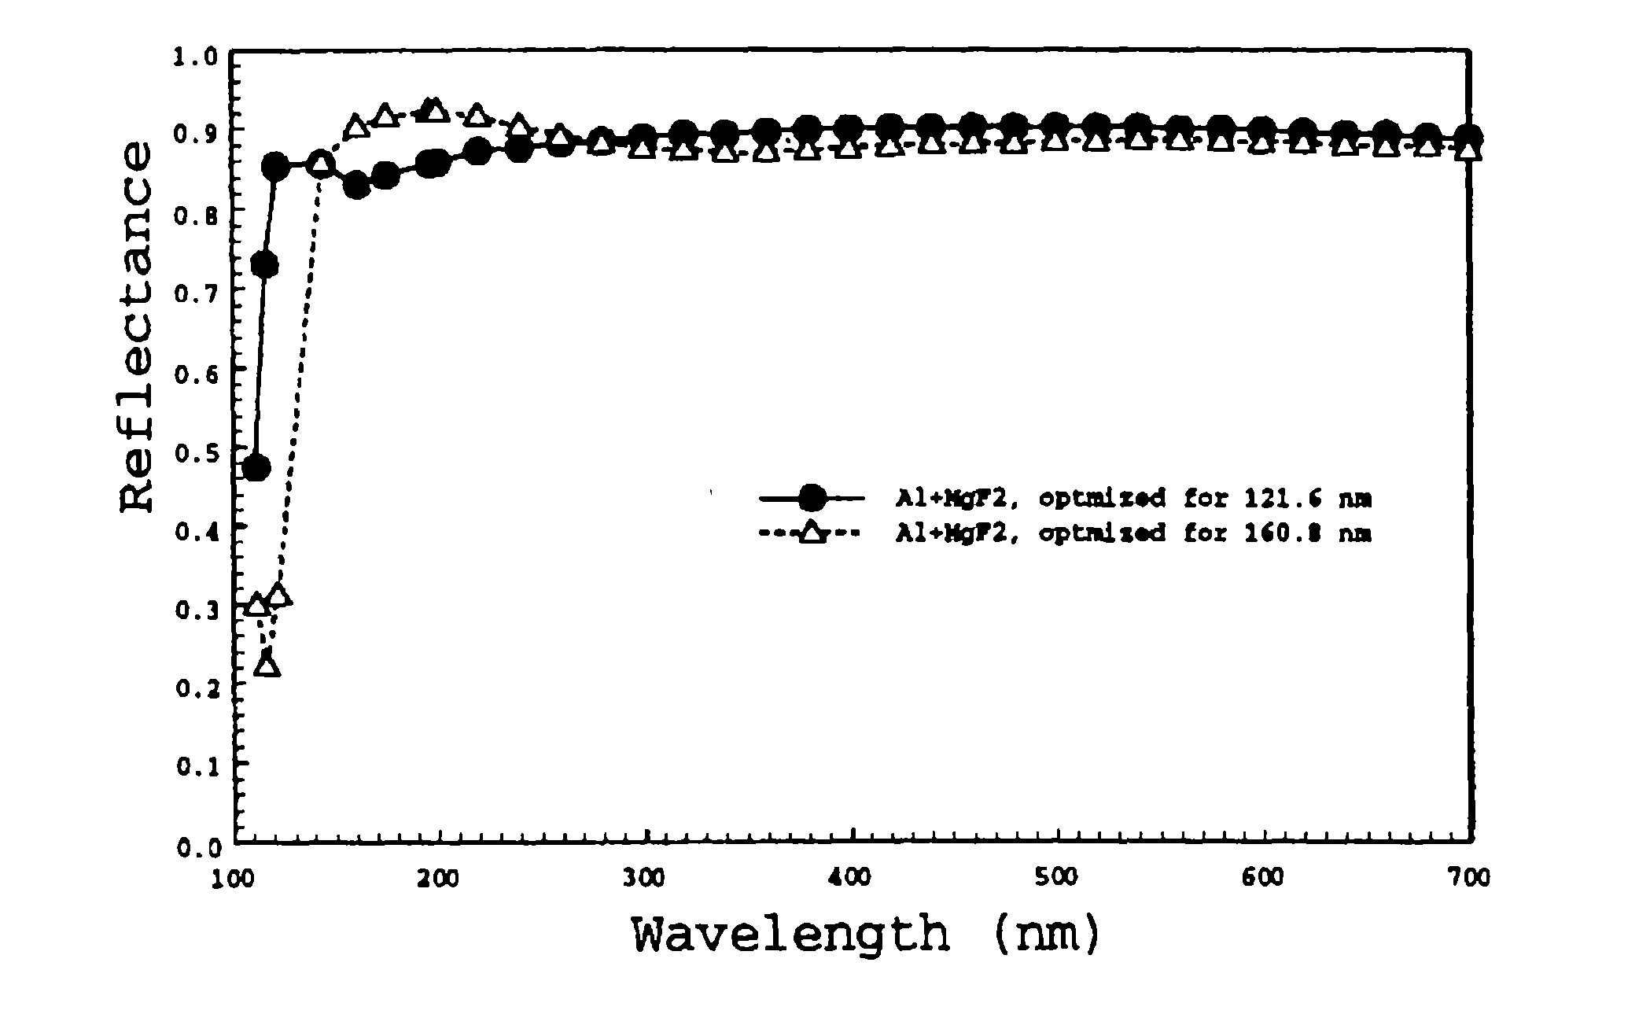
Al + MgF2 for > 1200 A

Slide 5
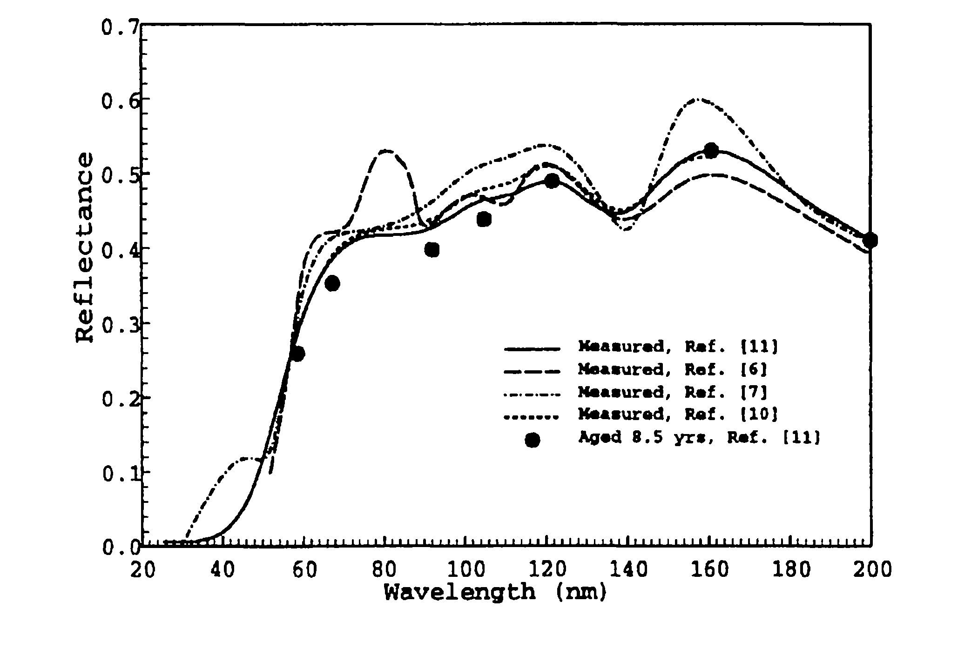
SiC for > 600 A

Slide 6
LOSS of REFLECTIVITY IN SPACE
In near earth orbits atomic oxygen is present
If surface-vector of the mirror points in the direction of motion of S/C, oxygen atoms hit with ~ 5 eV energy and react with surface
S/C velocity
Mirror-surface

Slide 7
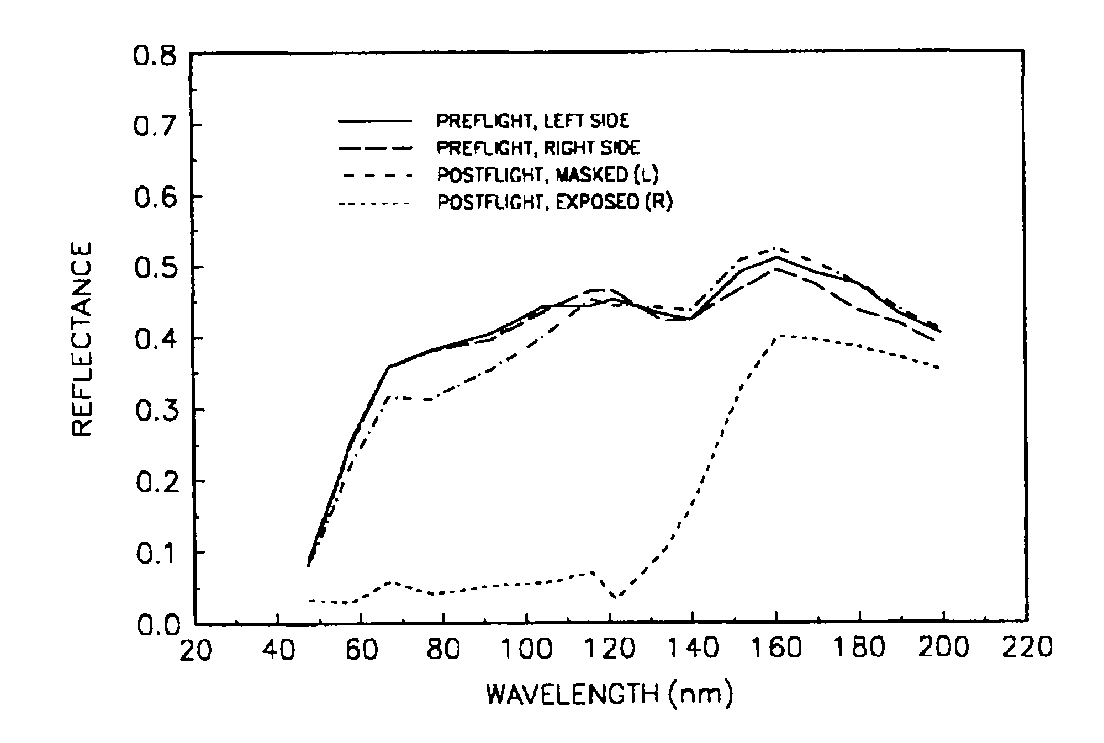
Loss in Reflectivity Due to
Exposure to Oxygen in Orbit

Slide 8
MATERIALS etc.
The absorption cross sections increase fast for λ < 2000 Å
For λ < 2000 Å, all the tests require vacuum
For λ < 1200 Å, all the optics to be reflecting
For λ < 2000 Å, nm or less thickness of some materials on the surfaces can reduce efficiency seriously
Materials can evaporate and migrate to the optical surfaces – this must be avoided by careful selection of non-metals for construction

Slide 9
DETECTORS
Back-illuminated CCDs made with Si can be used for detecting UV
if the longer wavelengths are blocked
(these have much larger flux, and filters are difficult to make for λ < 2000 A)
dark current is reduced by cooling
condensation on cooled surface to be avoided
Materials with large band gaps like “GaN” can be used to avoid background of long λ
Read noise is a serious problem- low fluxes

Slide 10
DETECTORS
Photo-emissive detectors with high threshold, and multiplication of photo-electrons are used to get low dark current/ZERO-readnoise and elimination of larger wavelengths
QE is low, e.g. ~ 5-20%
Such detectors are used in UVIT
MCP intensifiers, placed close to the photo-cathode, convert each photo-electron to a pulse of ~ 1 million electron

Slide 11
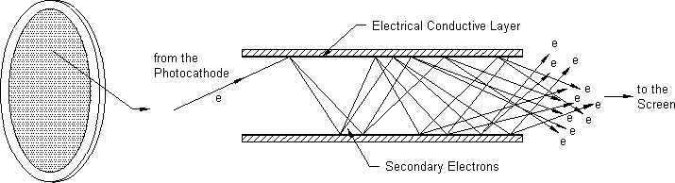
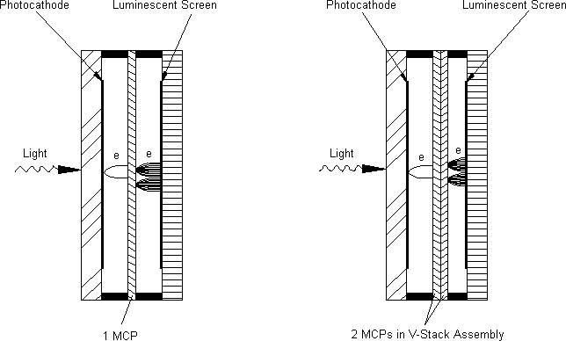
PHOTO-CATHODE & MCP

Slide 12
DETECTORS
Requires high voltages ( up to ~ 5 kV)
The pulse of electrons is detected and its position measured to give position of the detected photon
For a million electrons, the central position can be measured with little error to get a high spatial resolution limited primarily by drift of photo-electrons in travel to MCP, and pore size of MCP

Slide 13
UV PHOTON COUNTING DETECTOR
PHOSPHOR OR MESH of ELECTRODES
Photo-cathode on MCP
Can Give higher QE
/CMOS

Slide 14
IMAGING with SATELLITE -DRIFT
Ideally pointing error to be < 0.2 of FWHM
Difficult to get such pointing
Pointing drifts by several (“) at rates ~ 1”/s
An exposure of several seconds blurs PSF
Exposure of < ~ 0.1 s does not blur PSF
BUT has too few photons to make an image
SOLUTION: Shift and Add short exposures
NOT useful for spectroscopy with slit
NOT useful if read noise is finite

Slide 15
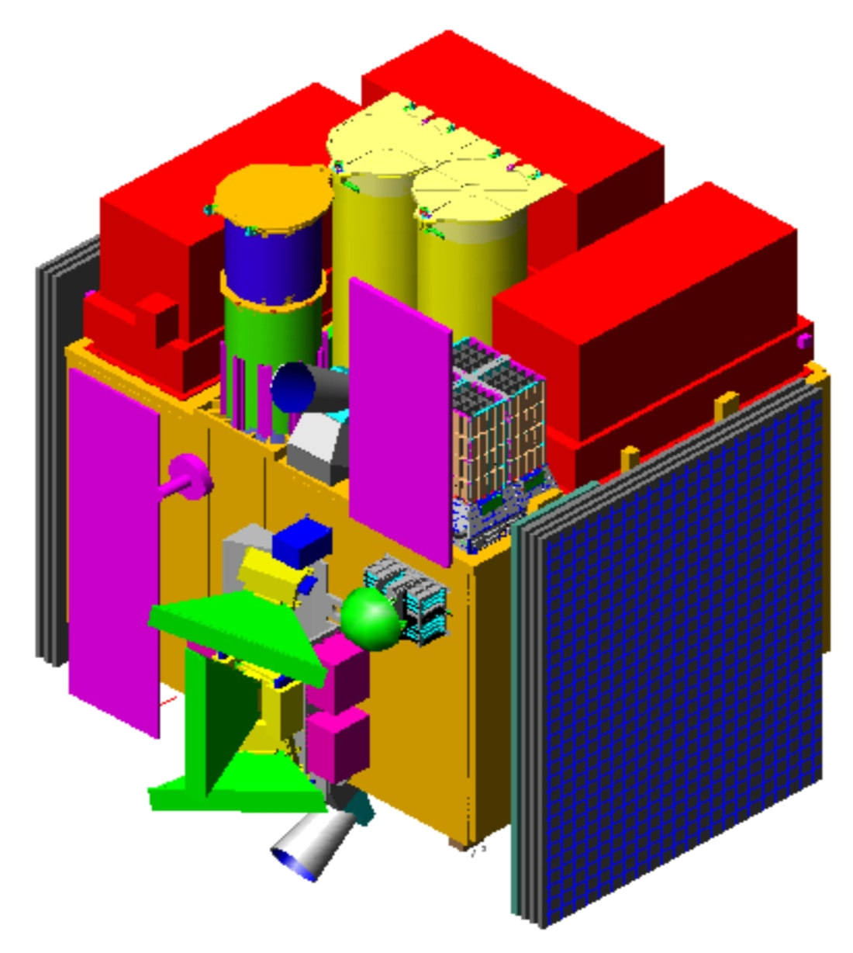
ASTROSAT & UVIT
UVIT
LAXPC
SXT
CZT
Star Sensors
Phased Array Antenna
SSM

Slide 16
UVIT
COLLABORATING INSTITUTIONS
ISRO, India & CSA, Canada
IIA, IUCAA, and TIFR India
Herzberg Institute and Un. of Calgary Canada

Slide 17
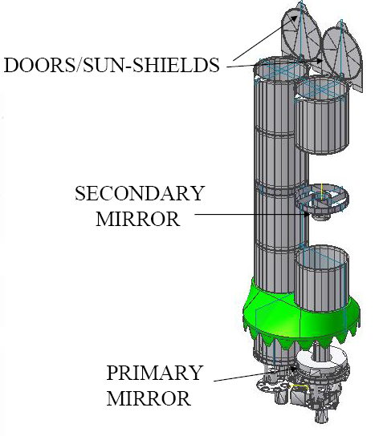
UVIT- Configuration
BLACK BAFFLES TO MINIMISE
STRAY LIGHT
DETECTORS and FILTERS

Slide 18
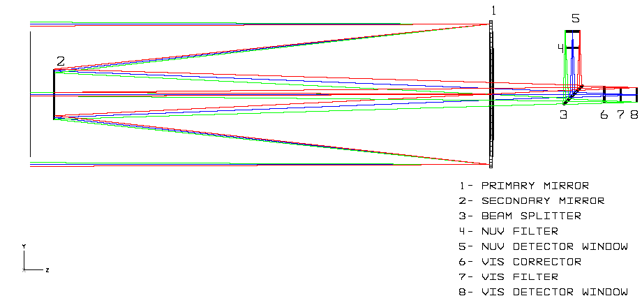
NEAR UV & OPTICAL TEL.
(SIMILAR FUV TEL.)
Notes:
18

Slide 19
SPECIFICATIONS of UVIT
SIMULTANEOUS IMAGING IN
FUV (130-180 nm) NUV (200-300 nm)
(Images in VIS only used for tracking the drift)
Multiple filters, and gratings for slit-less spectroscopy (res. ~ 80) for both channels
FWHM of PSF ~ 1.4”
Peak Effective Area: FUV /NUV ~ 12/40 sq. Cm
Photometry better than 10%
Astrometric Accuracy (CORRECTED ) ~ 0.4”.
Notes:
19

Slide 20
SOME DETAILS OF IMAGING
Photon detection and position measure
Corrections to each detected photon
position for relative drift of the frame
position for Distortion
for flat-field, i.e. effective no. of photons at centre of the field
correct the position for drift of S/C
Correction for Saturation in the final image
Results of In-orbit Calibrations

Slide 21
UVIT-DETECTORS
3 intensified detectors with CMOS imagers
One for ~ 125 -80 nm (FUV), one for 200-300 nm (NUV), and one for 320-550 nm(VIS)
Aperture ~ 39 mm, and resolution ~ 0.03 mm
QE ~ 12% for NUV, and ~ 5% for FUV

Slide 22
PHOTON POSITION ...
Photon
Photo-electron
Pulse of electrons ~ 1 million & 0.1 mm wide
PHOSPHOR
/CMOS
Pulse of light ~ 0.03 mm

Slide 23
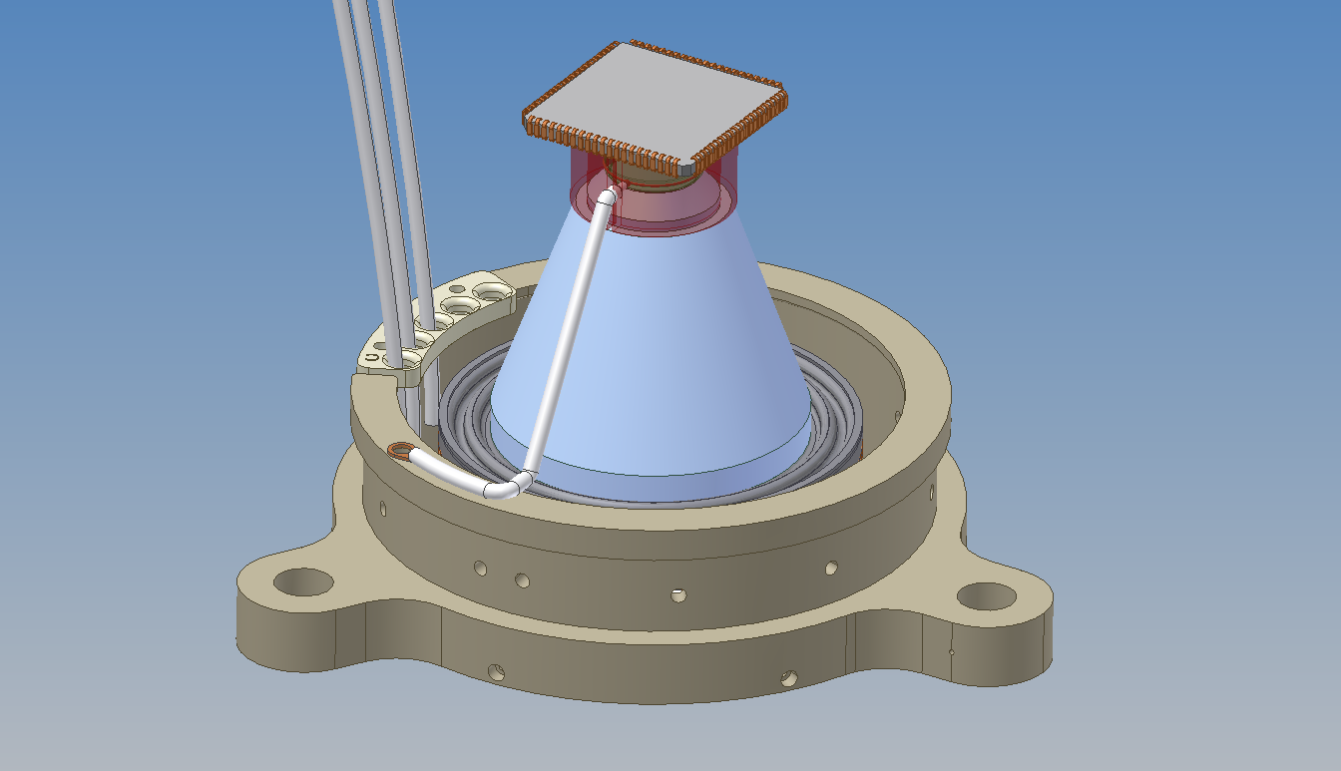
DETECTOR MODULE
CMOS-IMAGER
Each 25 micron pixel
is ~ 3” x 3”
Fibre-taper
~ 3 : 1
Notes:
<number>

Slide 24
PHOTON POSITION ...
The intensified photo-electron is ~ 0.1 mm dia
Pulse of electrons
Centroid of the pulse can be measured by a series of electrodes, or by a CCD etc after conversion to pulse of light
In UVIT-detectors, the light is transferred to a CMOS-imager via a 1:3 fibre-taper
The light spot is ~ 0.03 mm FWHM, and CMOS-pixels are 0.025 X 0.025 mm or 3.3”

Slide 25
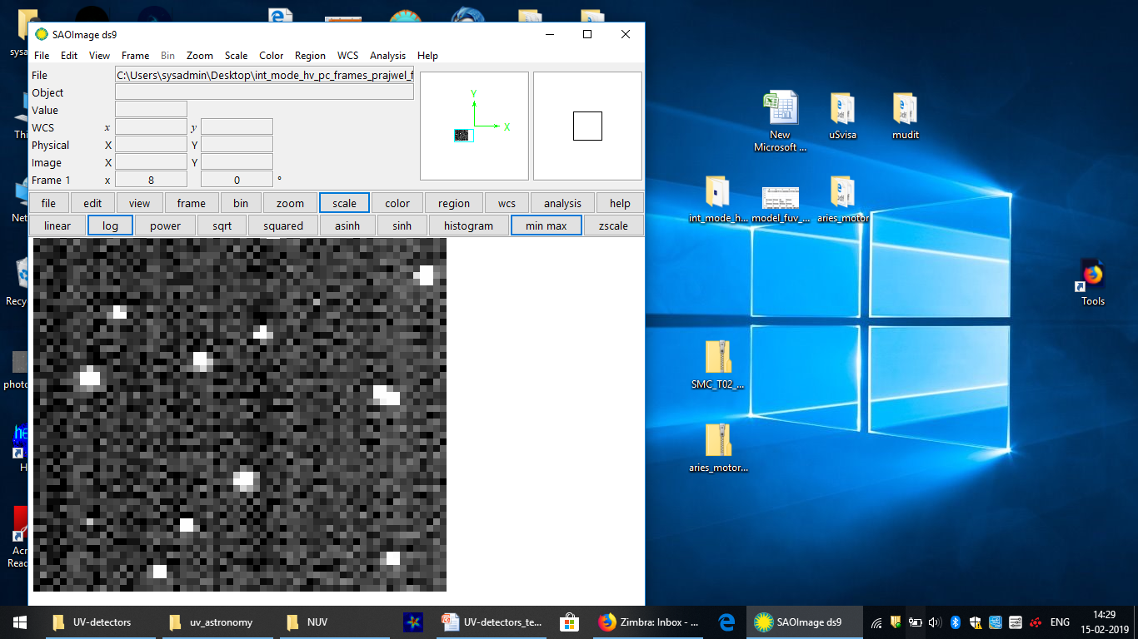
Photon Position ...

Slide 26
PHOTON POSITION ...
X,Y -Centroid of the pulse traces X,Y-photon
Centroid is found for 3X3 pixels of the pulse, and it gives some systematic error up to 0.1p
Corrected positions have RMS errors ~0.004 mm/0.15” on the window/photo-cathode
The cross spread of photo-electrons reaching MCP is ~ 0.015 mm or ~ 0.5” RMS

Slide 27
CORRECTION for DISTORTION
Distortions in optics are << 1”
Fibre-taper in detector is the main source of distortion
Transformation from CMOS-imager to the window deviates from linearity by up to 6”
Distortion is calibrated on ground
Corrections give linearity to better than ~ 0.3”

Slide 28
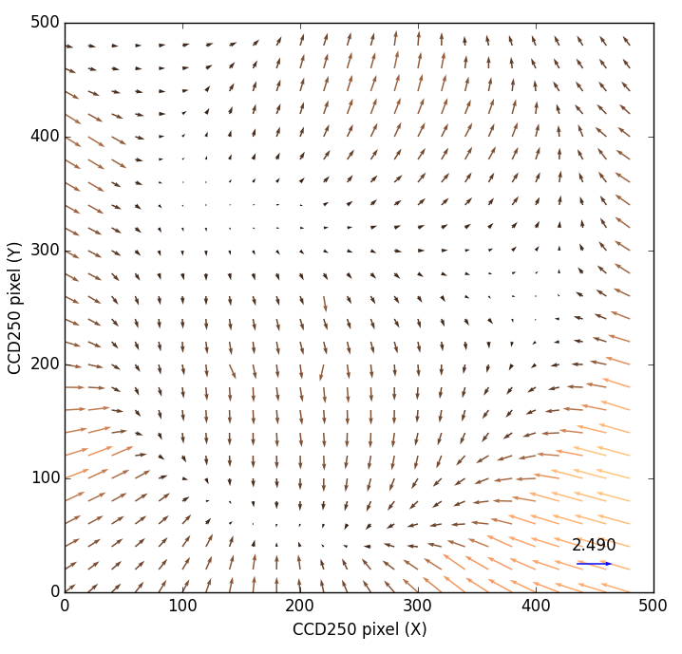
DISTORTION for NUV
PIXELS (~ 3.3”)

Slide 29
CORRECTION for DRIFT
VIS images taken every second
One VIS image taken as reference
Stars in each image used to find drift wrt the reference image in units of VIS-PIXELS
The drift from VIS transformed to drift in NUV/ FUV-PIXELS for each exposure (< 0.1 s)
NUV/FUV exposures (each < 0.1 s) shifted as per the drift and added
For some fields NUV/FUV exposures may have enough photons to get drift every second

Slide 30
SATURATION-CORRECTION
Full field images are taken at ~29 frames/s
If 1 ph./s detected for a source, two ph. in ~ 1.5% of the frames are detected as one ph. OR a saturation is seen of ~ 1.5%
For strong sources imaging can be done at higher rate, say 300 frame/s, for partial field
For point sources
Empirical relation is found, for observed rates up to 0.6 ph./frame ~ 17 ph/s (29 f/s), to make corrections to ~ 1%

Slide 31
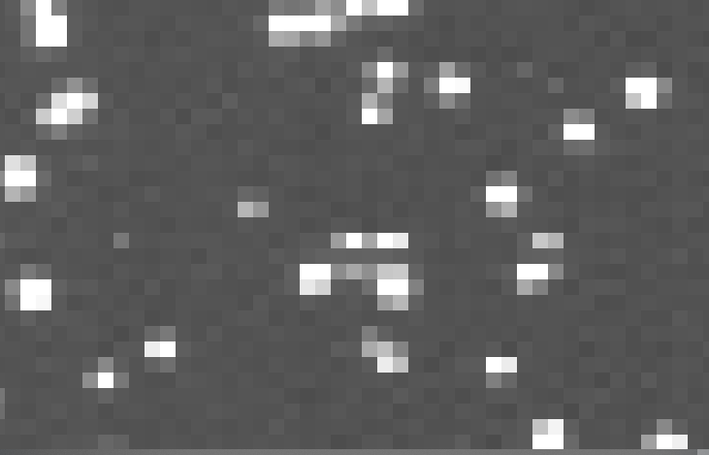
PHOTON-EVENTS

Slide 32
IN-ORBIT CALIBRATIONS
Ground calibrations lead to estimates of the performance
Final test of the performance only in orbit

Slide 33
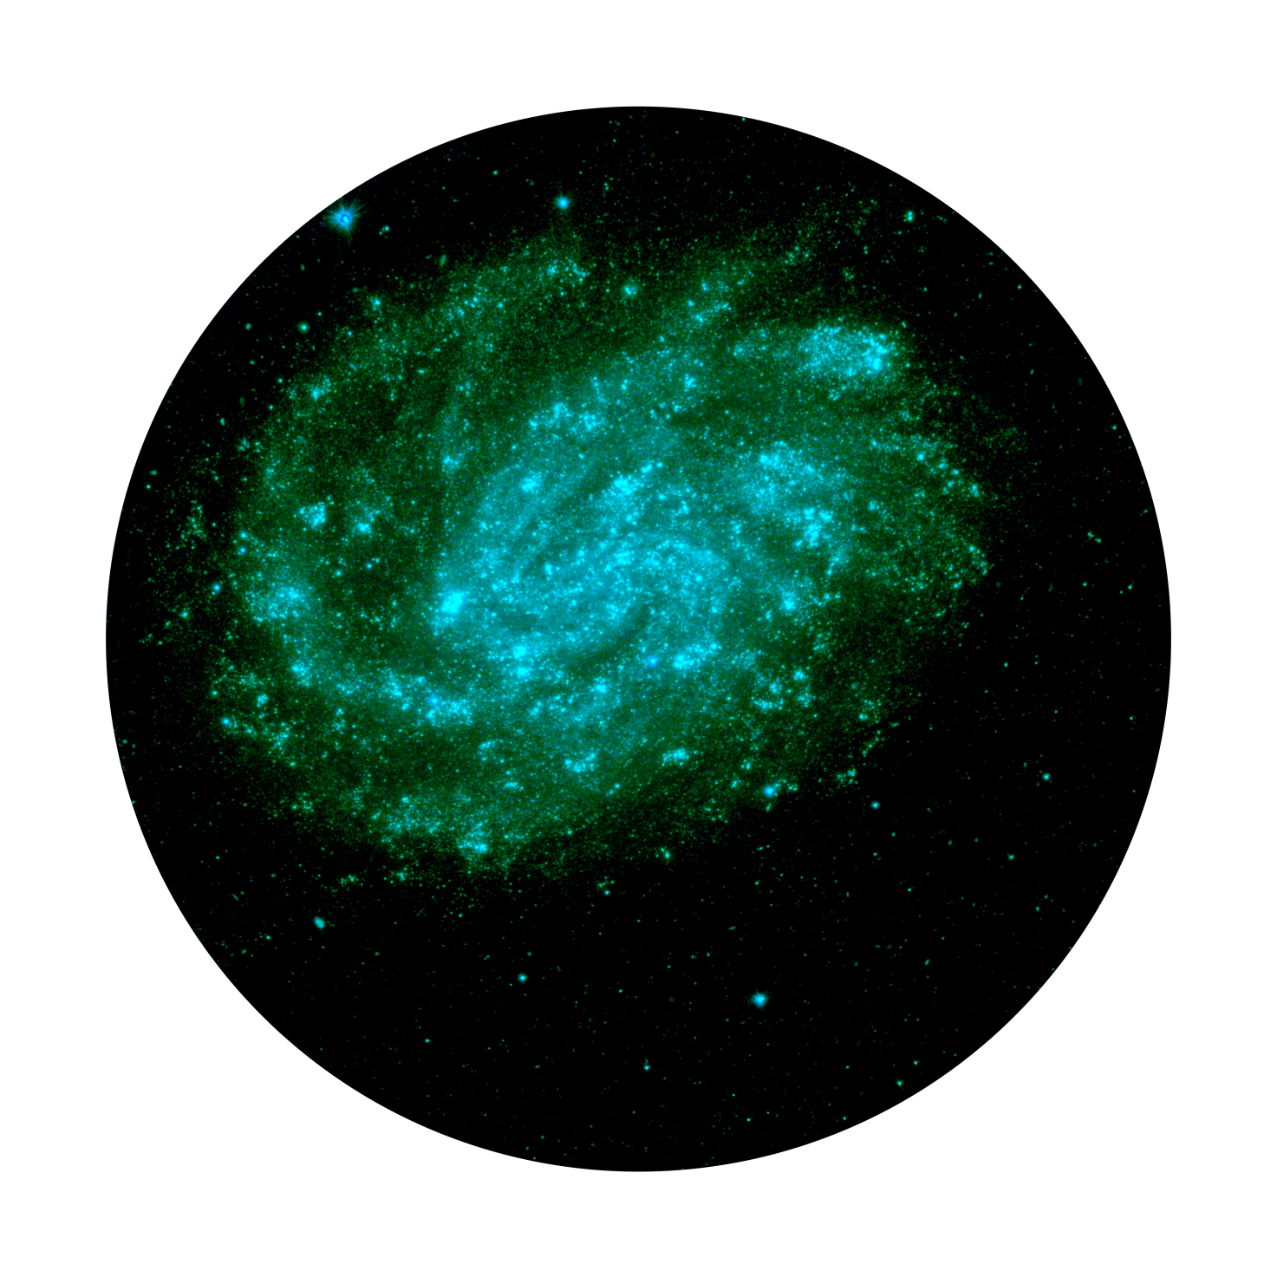
NGC 3000

Slide 34
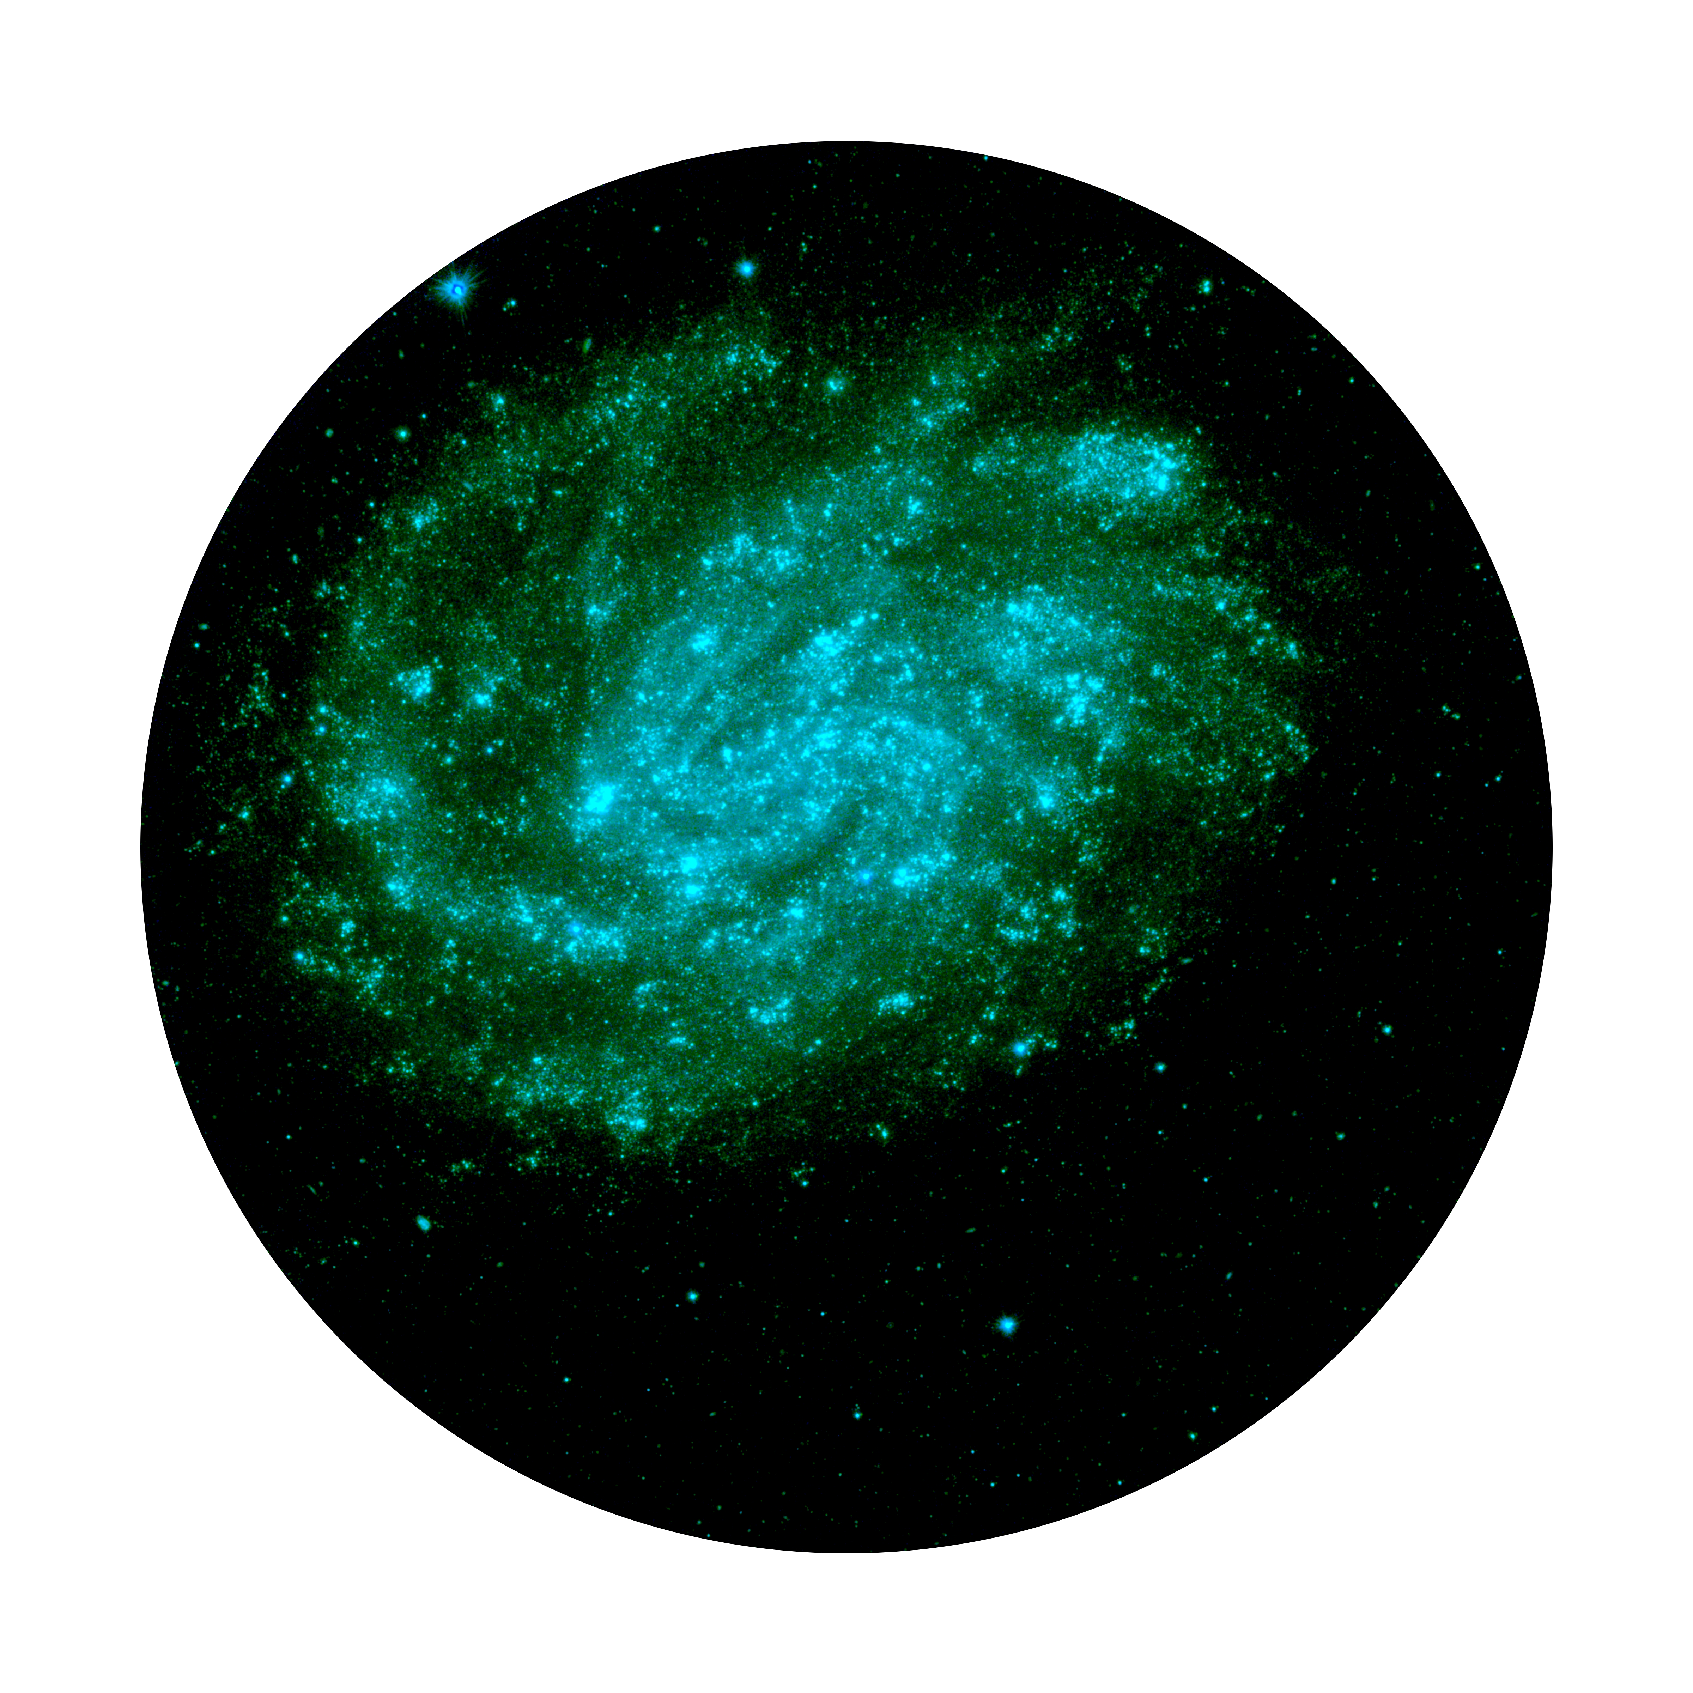

Slide 35
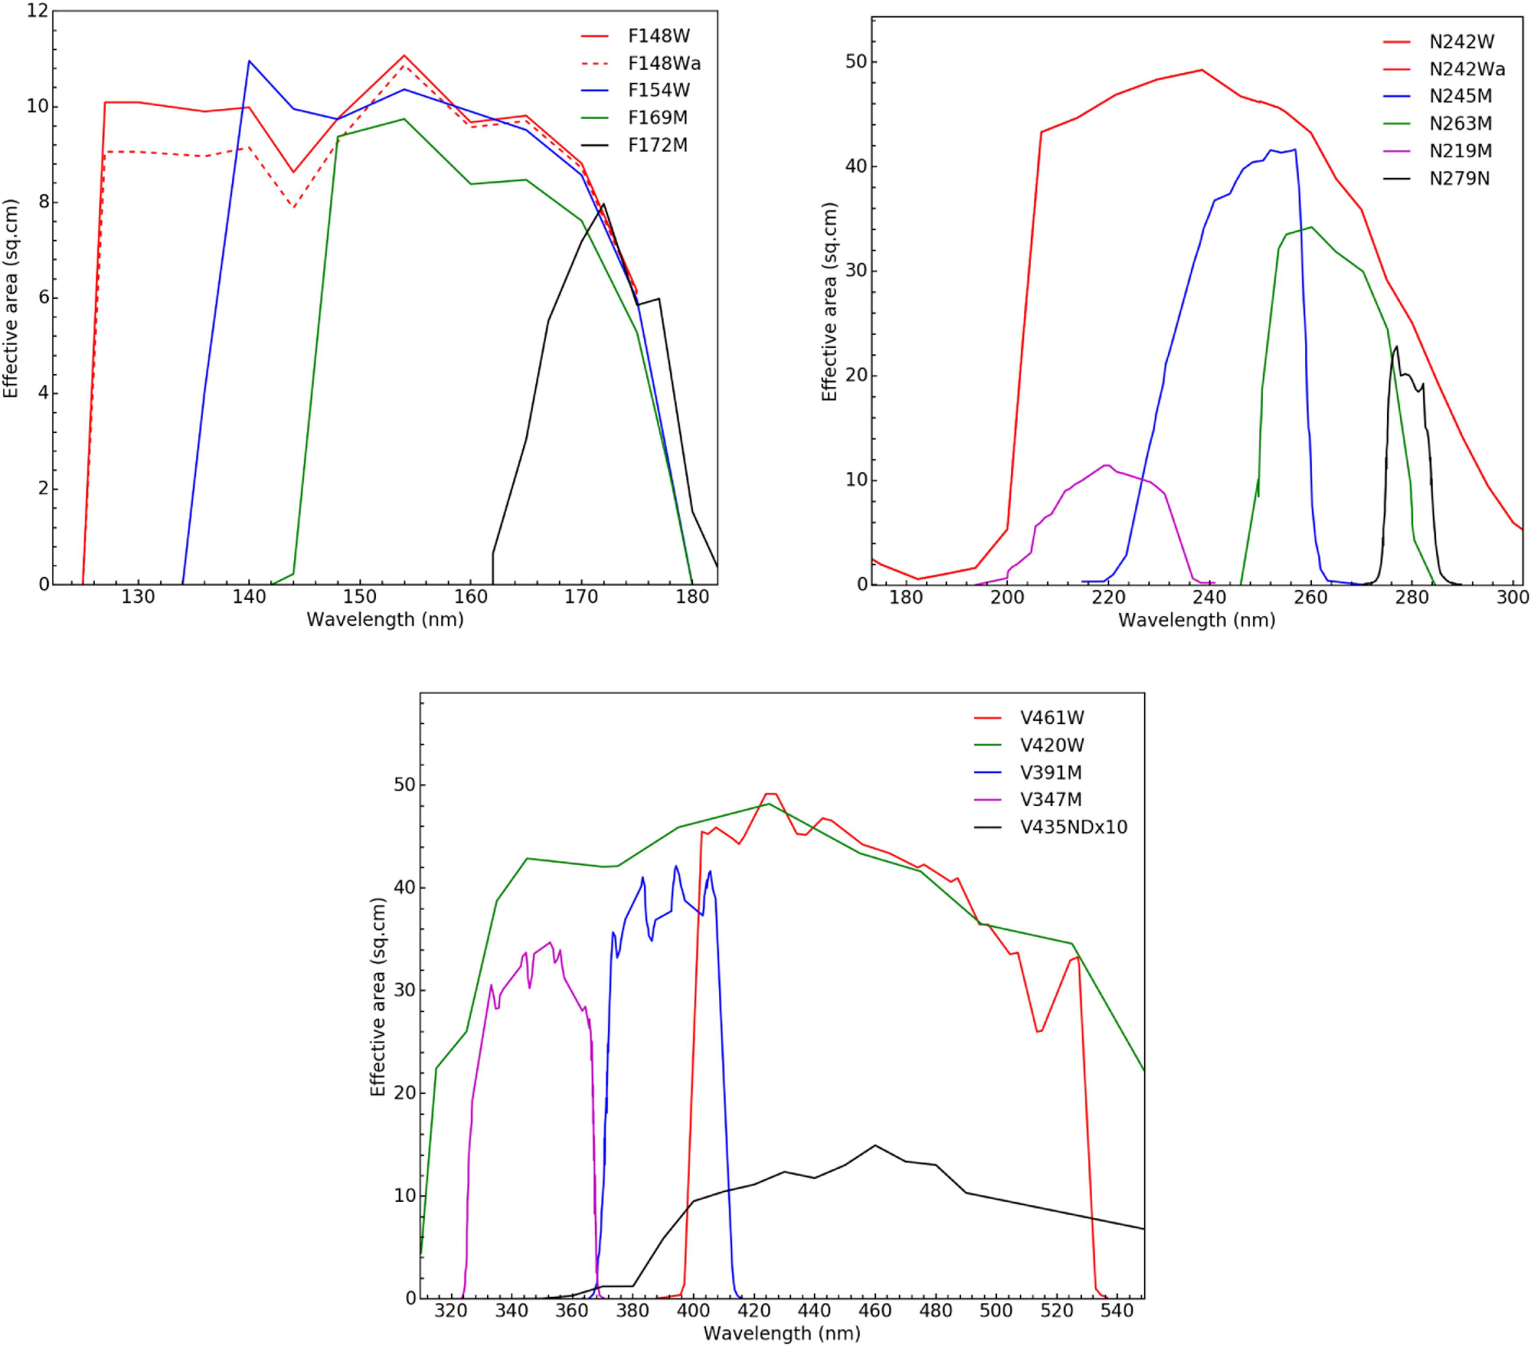
FILTERS -FUV
Multiplicative_Correction factors from on –orbit calibrations
F148W: 0.785; F154W: 0.780 ; F169M: 0.917 ; F172M:0.903

Slide 36
FILTERS - NUV
Multiplicative_Correction factors from on –orbit calibrations
N242W: 1.032; N245M: 0.795 ; N263M: 0.824 ; N219M:0.518; N279N:0.846

Slide 37
FILTERS-VIS
Notes:
<number>

Slide 38
ZERO ...
The Zero Point mag are derived from :
known spectrum of an observed standard source & spectral dependence of the eff. area for filter, along with the measured C/S
The standard source is Hz4, and the ZP mag. refer to the energy in full PSF ( ~ 25” radius)
The measured C/S for a standard source can give average correction factors for eff. Area of the filters
SED cannot be derived by converting the mag. to flux at the average wavelength, but modelling is required with eff. Area vs λ of the filters and assumed SED

Slide 39
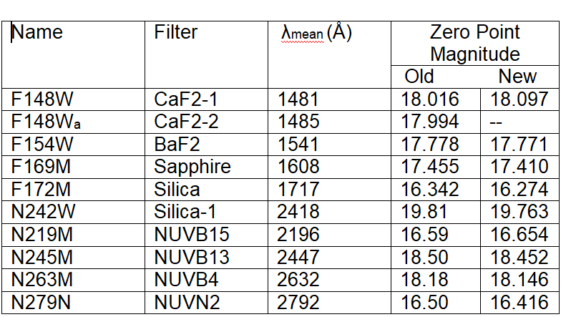
ZERO-POINT MAG. (for 1 C/S at Centre)

Slide 40
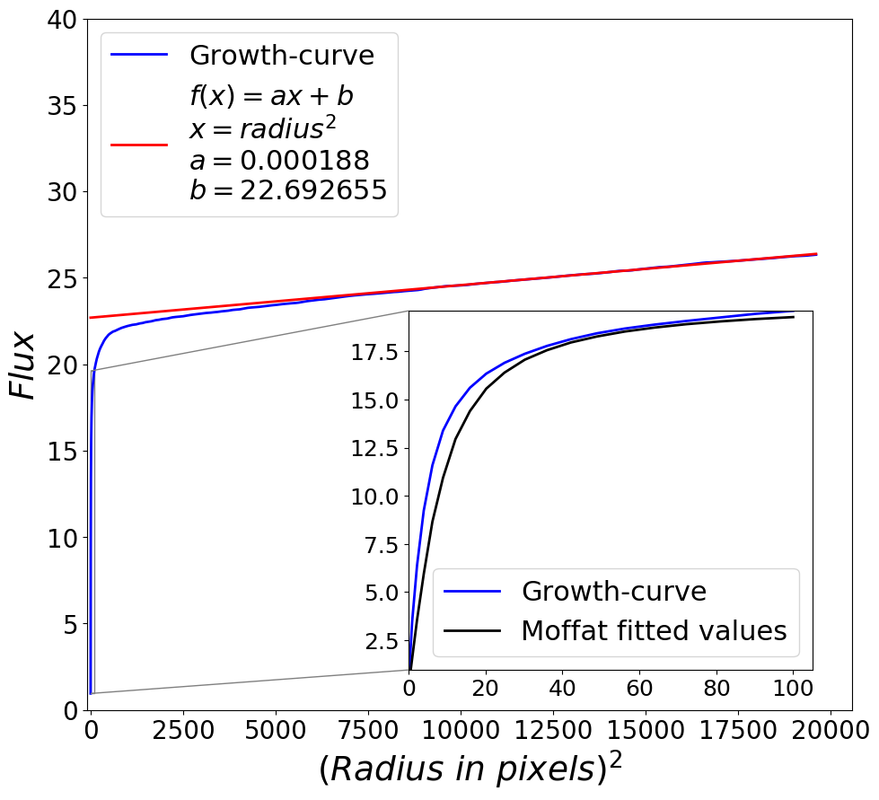
PSF
87% Energy in radius 4”
50% Energy in radius 1”

Slide 41
PSF ...
The core of the PSF, say dia < 2”, relates to aberrations in the optics and defocus, and may vary with filter and position in field
The outer part of the PSF relates to the various scatterings – roughness of the optical surfaces, obstructions due to ribs etc. – and would not vary with filter or position.

Slide 42
DISTORTION/ASTROMETRY
Distortion affects position as well as PSF
For reliable matching of sources, e.g. In a crowded field, astrometry should be better than 0.5 FWHM or < 0.6”

Slide 43
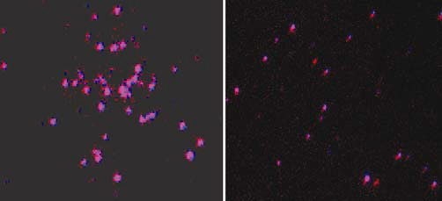
DISTORTION-CORRECTION
Matching FUV & NUV
70 ” Near Centre 140” Near Edge

Slide 44

DISTORTION-CORRECTION
Matching FUV & NUV
140” Near Edge

Slide 45
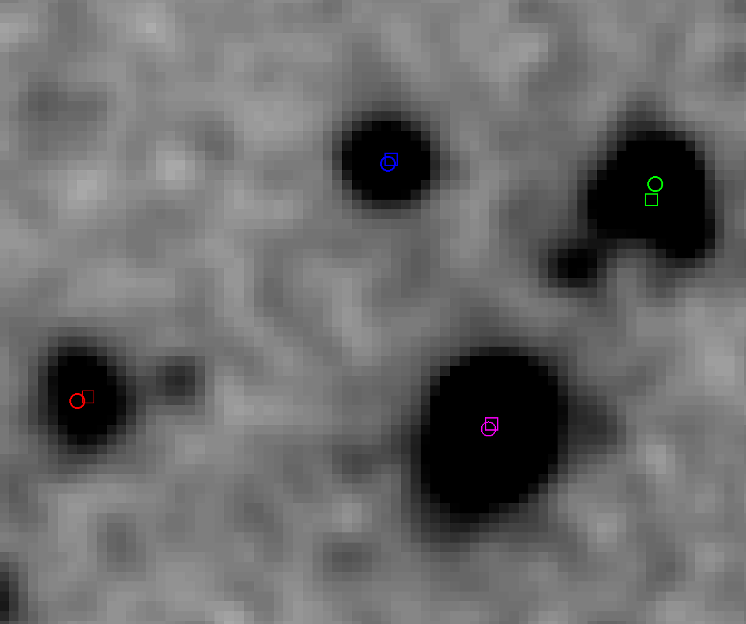
MATCHING WITH HST-POSITIONS
OVER ~ 10’ FIELD (pixel is ~ 0.4”)

Slide 46
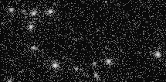
NEW_DISTORTION CORRECTION
( Pixel ~ 0.4”)

Slide 47
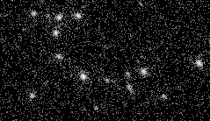
OLD_DISTORTION CORRECTION
(Pixel ~ 0.4”)

Slide 48
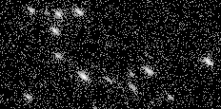
NO_DISTORTION CORRECTION
(Pixel ~ 0.4”)

Slide 49
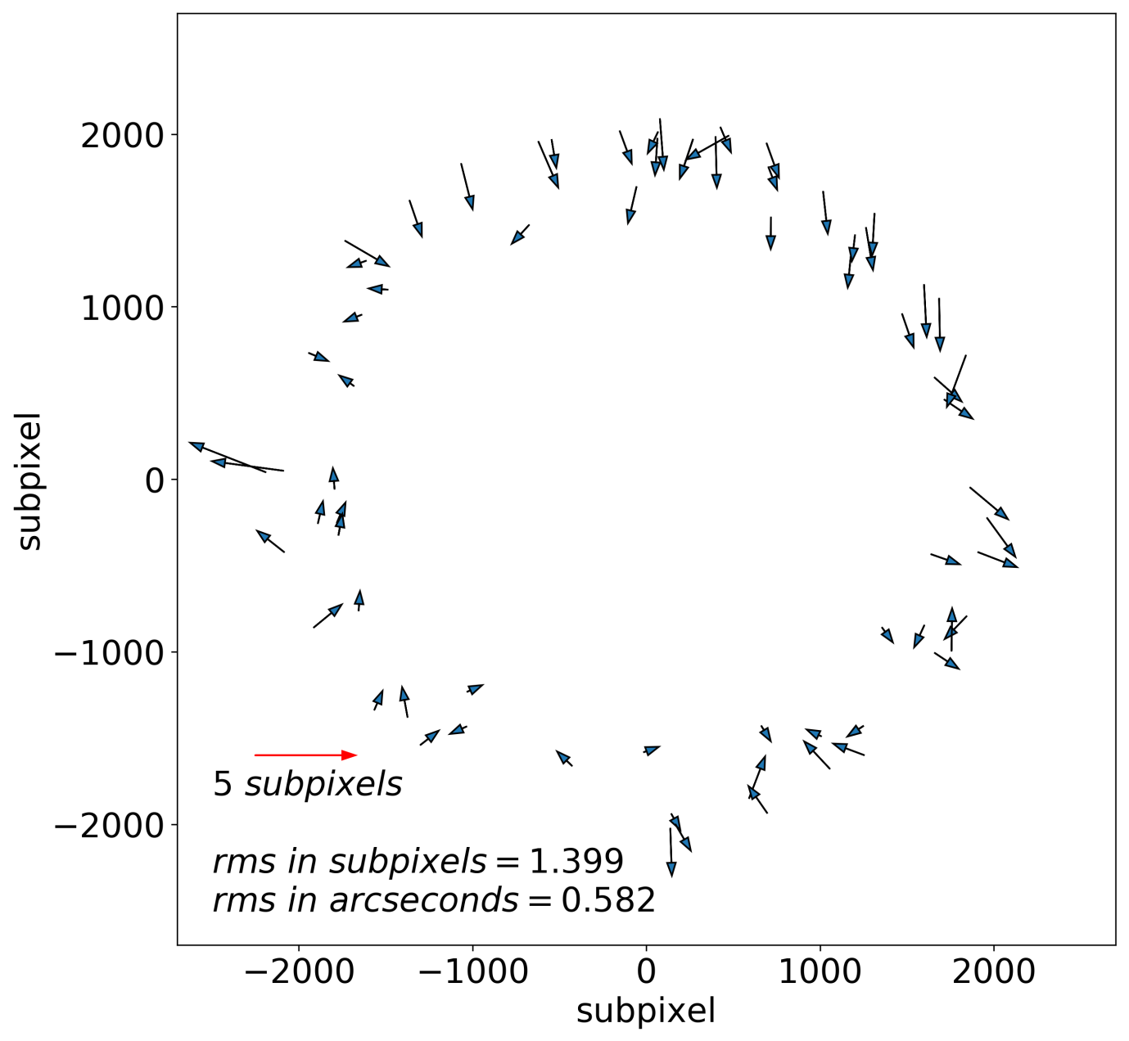
RELATIVE ASTROMETRIC ERRORS FUV VS NUV for SMC
(Only shown near the edges – worst in the field)

Slide 50
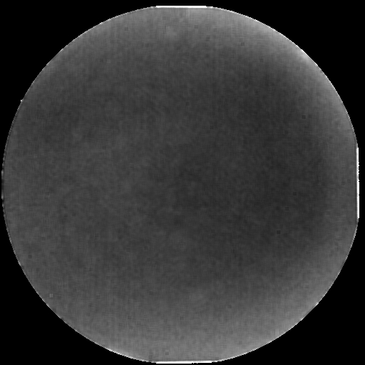
FLAT-FIELD Calibration: FUV
(Range 1.00 to ~ 1.13)

Slide 51
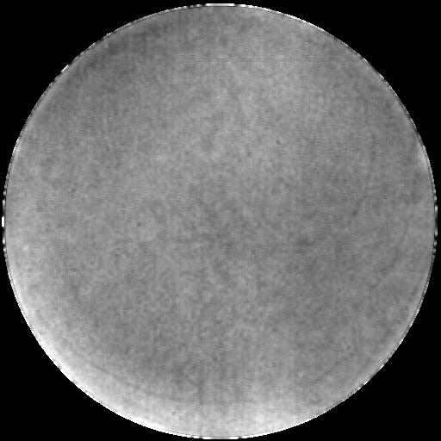
FLAT FIELD ... : NUV 242W
(Range 1.00 to 1.06)

Slide 52
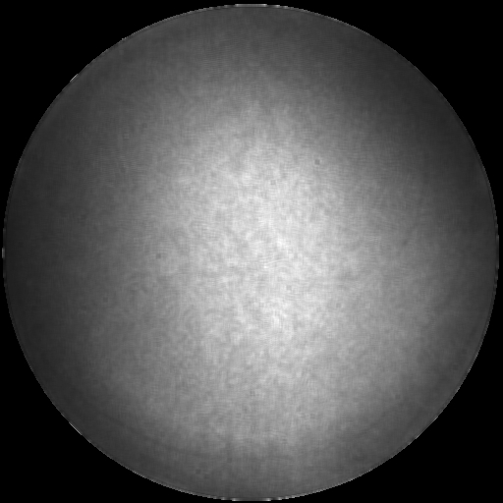
FLAT ... : NUV 219M
(Range 1.00 to 0.700)

Slide 53
SPECTRAL CALIBRATIONS
Two Gratings for FUV (with orthogonal lines)
One grating for NUV
Dispersions and Effective area calibrated

Slide 54
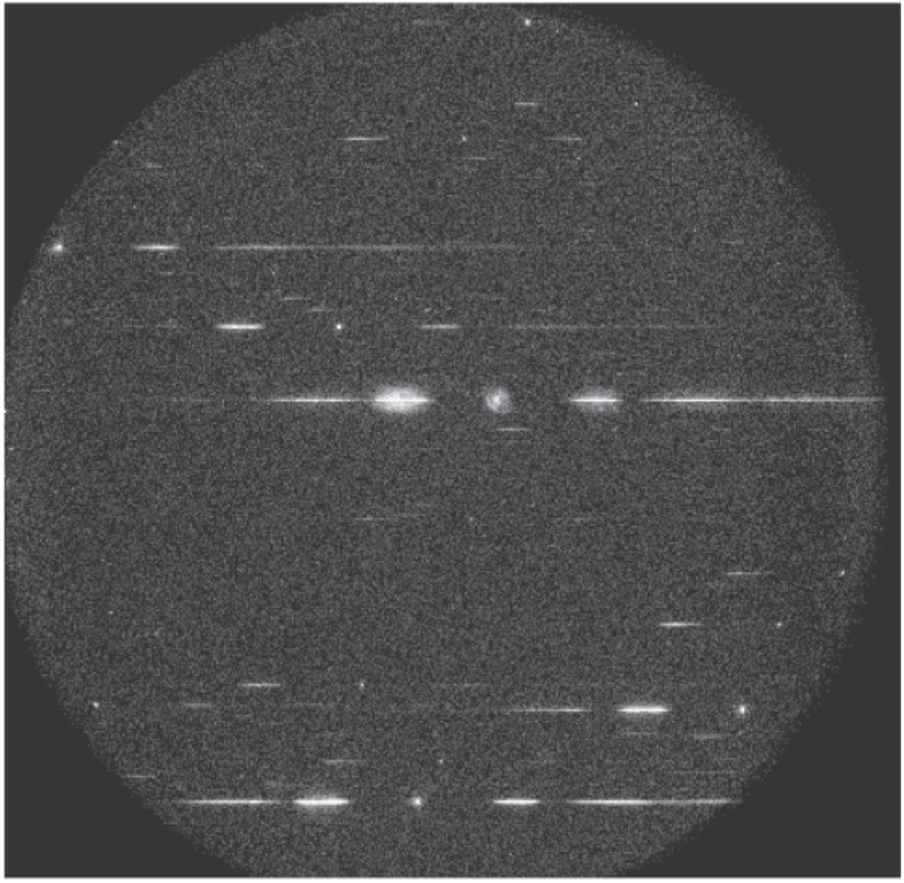
NUV-SPECTRUM

Slide 55
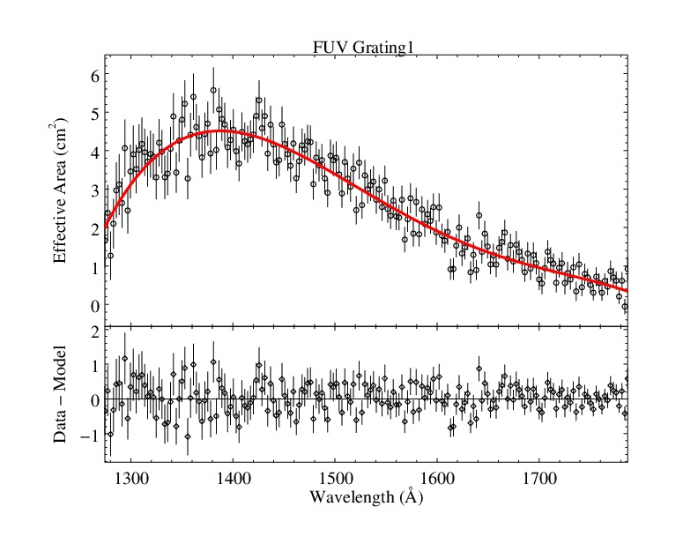
SPECTRAL ... FUV-Grating

Slide 56
DENSE FIELDS
In a Globular Cluster or SMC etc. there could be large density of stars, i.e. PSFs overlap:
Use aperture/ PSF Photometry
Aperture of a radius ~ 4”, with ~ 88% energy content, would ensure that the correction required is not variable over the field/filter
In PSF photometry , variation in core of PSF over the field/filter should be considered
In case the fluxes are high there would be saturation effects which can only be corrected by detailed modelling of the detector
.

Slide 57
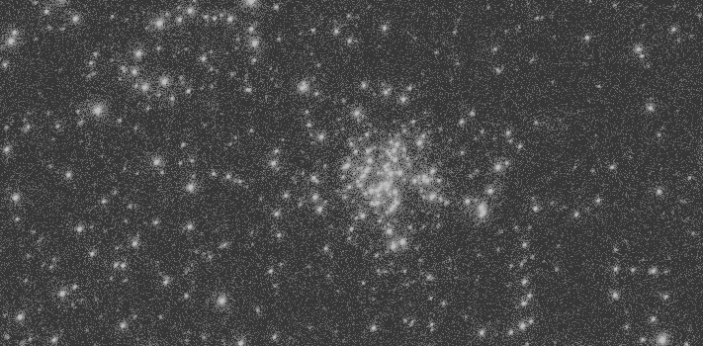
SMC (~ 5’ wide) NUV

Slide 58
DEEP FIELDS
Long exposures for faint objects
Select filter for lowest background, e.g. BaF2 instead of CaF2 to avoid OI line
Discard frames with Cosmic Showers
Large source density gives source confusion
Good astrometry important for matching with images and identifying genuine sources.
ll

Slide 59
BACKGROUND
Geocoronal lines: Important for FUV
Zodiacal Dust: Important for NUV
Extra solar: varies with Galactic Lat as well as Longitude
Cosmic Showers: Important for FUV
Background subtraction: NOT BY MEDIAN of THE COUNTS IN PIXELS ?
Min. measured Bkg. for FUV_BaF2 :~ 28.8/sq “
OR background limited mag is 26.8, which is close to confusion limit

Slide 60

CDFS- BaF2-50000 s (35”)

Slide 61
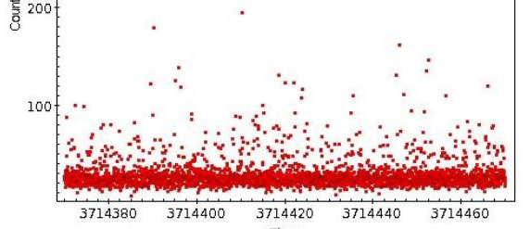
COSMIC-SHOWERS
(X-frame no., Y- no of events

Slide 62
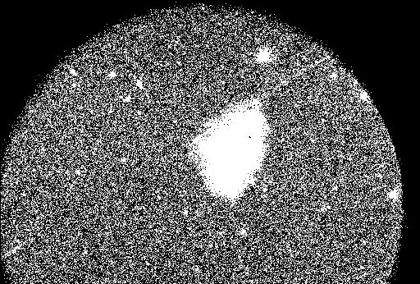
ARTIFACTS

Slide 63
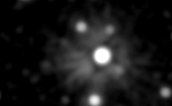
VALLEY_SATURATION

Slide 64
CDFS- BaF2-50000 s (35”)

Slide 65
CONTAMINATION CONTROL
Monomolecular layers can absorb a lot for wavelengths < 2000 A
Materials can evaporate and migrate to optical surfaces in lab/orbit
Any plastics exposed to Solar-UV can emit molecules which deposit on optics
A cooled detector attracts molecules from the warmer structure etc.
Great care is required in selecting materials used:
structure, blackening-treatment, cables, ..., testing laboratory, testing equipments, and vacuum chambers

Slide 66
Deficiecies
Timing of the frames
NUV has failed : ~ March 2018

